Slide 1
DESN2000 MECH Workshop
Week 7 – Sensors

Slide 2
Class overview
Sensors in everyday life
(5 min)
Analogue and digital
( 5 min)
System/circuit diagrams and pseudocode
(15 min)
Report integration
(10 min)
Project time!
(80 min)
Summary
(5 min)

Slide 3
Before we start…
What is a sensor?
Notes:
This and the following slide is a small preamble to get the class thinking a little. Spend no more than 5 mins on this section. You may use this opportunity to comment on how commonplace sensors are in everyday life, how our bodies are full of biological sensors (eyes, ears, sensory nerves etc.)
If students are still wondering what two topics to pick for their technical analysis, suggest sensor selection. It is almost inevitable that all their devices will require some kind of sensor just purely due to how commonplace and integral they are to enable the devices we use daily to function

Slide 4
What is a sensor?
A sensor in an electronic device, which receives inputs from the environment and outputs data, which is used by an engineering system to perform a function.

Slide 5
Sensors in everyday life
Sensors in everyday life | Analogue and digital | System/circuit diagrams and pseudocode | Report integration | Project time! | Summary
5 min | 5 min | 15 min | 10 min | 80 min | 5 min
All | All | All | All | All | All

Slide 6
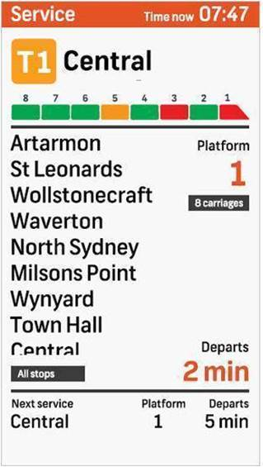
You likely have encountered many sensors today!
Sensors in everyday life
Activity - 10 minutes
Discuss in your groups, writing down every sensor that you’ve encountered today as well as what they do. Use the below format. Example: Sydney train capacity sensor
Sensor type: Weight sensors
Where: In the train bogies
Data input: train carriage weight
Data output: A low-medium-heavy indication on TripView about whether my train is full or not
When choosing/brainstorming sensors for your project, try to always take notes considering these four points. They will help you narrow down what sensors are most suitable for your use case, and can form the basis for your report on them.
Notes:
This is a short activity to further students in thinking about sensors in a more deliberate, systematic way. The four dot points (type, location, input and output) are essentially cornerstone topics that students should discuss in their reports if they choose to do sensor selection. You can mention this to students at the end of the activity, that they should consider these four topics when going about their sensor selection.

Slide 7
Further examples of sensors
Sensors in everyday life
Accelerometers Found in your phone to track your steps
Potentiometers Records a numerical value with a set range to control room light brightness
Buttons on the tram Records on/off pressed state, to detect if someone wants to open the door
Automatic door sensor Measures the change in infrared radiation to detect when a person is at the door.
Notes:
Some further examples if the class was rather quiet. Please throw in your own examples too to further the fact that sensors are everywhere.

Slide 8
Analogue and Digital
Sensors in everyday life | Analogue and digital | System/circuit diagrams and pseudocode | Report integration | Project time! | Summary
5 min | 5 min | 15 min | 10 min | 80 min | 5 min
All | All | All | All | All | All

Slide 9
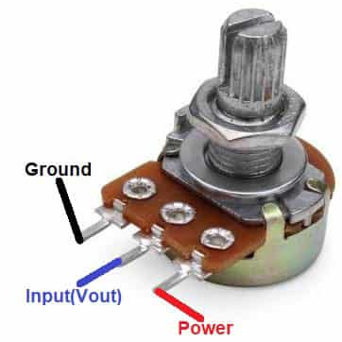
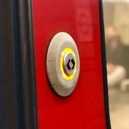
Analogue and Digital
Difference is in the output!
Analogue
Usually outputs a continuous, time-varying current, which changes in magnitude due to resistance.
Example: A potentiometer, depending on the position of the dial, changes its electrical resistance which in turn changes the magnitude of the current which it outputs.
Digital
Outputs a discrete, binary signal that would show as a square wave on an oscilloscope.
Example: A button has only two states, on or off.
Notes:
This is a generalised overview between the difference between analogue and digital sensors. Feel free to customise with an extra slide showing more examples of each type.

Slide 10
Analogue and Digital
Analogue
Pros:
Higher resolution
Great for audio/video transmission
Limitations:
Vulnerable to noise and interference
Generation loss (taking a picture of a picture reduces the resolution)
Digital
Pros:
Less vulnerable to interference
Can be transmitted long range
Limitations:
More power demanding
More bandwidth compared to an analogue system transmitting the same information
The choice of sensor will depend on your use case and what you prioritise as most important. Be sure to justify your decisions.
Notes:
These are also some generalised comparisons between analogue and digital sensors. Reinforce to students that this is not an exhaustive list, and that they should do their own research to find out the types of sensors that are available for their needs and evaluate what is best based on their requirements. This research and justification are great things to talk about in the report. If you have any other pros and cons that you know of, mention them to your students here.
A good comment to mention to students here is that sometimes, the same variable (e.g temperature) can be sensed using both analogue and digital methods, so students aren’t confused thinking that certain variables can only be detected by certain methods of sensor construction.

Slide 11
System/circuit diagrams and pseudocode
Aka. Things we’d love to see in your report :)
Sensors in everyday life | Analogue and digital | System/circuit diagrams and pseudocode | Report integration | Project time! | Summary
5 min | 5 min | 15 min | 10 min | 80 min | 5 min
All | All | All | All | All | All

Slide 12
Systems diagrams provide a high-level view of how information is gathered, processed and transferred between the subcomponents of your device.
System diagrams
Example: Tram door button
Power Supply
electricity
Physical Pressure
Passenger: Wishes to open door
Button
Motor Controller
Servo Motor
Open signal
On-command to servo motor
Torque application
Identify inputs/outputs
This informs the reader how an action is converted into a signal, how it is processed and contributes to providing the desired function.
Door Opens
System diagrams vary in size and depth. This would be an example of a subsystem diagram (since it does not include the other onboard systems of the tram).
If your device has more than one sensor, you may choose to do a systems diagram for each of them, and then combine them all on a single, whole systems architecture diagram to show how they interact as a single unit.
Notes:
This is an example I made that demonstrates what a systems diagram might look like for a simple push button that opens the doors on the light rail.
The key thing to point out is that the inputs and outputs (the arrows) should be labelled so the reader understands what is being transferred between the sensor and other components, and how said signal is being processed/converted. Ideally, these outputs should be quantified where possible (e.g what specific voltage).
Also, this is definitely something that we expect to see on the final report if students choose to do sensors selection as part of their technical analysis, so point this out to students as well.
If you have a systems diagram from your own report that outlines the key points in a much more detailed way, please use that instead.

Slide 13
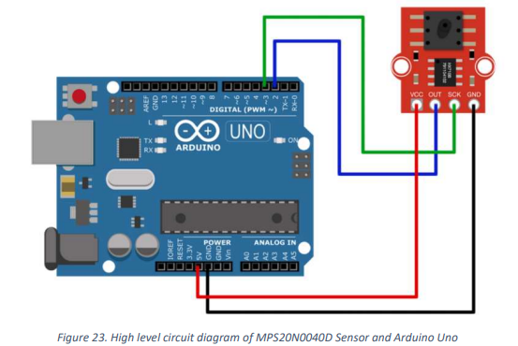
Similar to systems diagrams, circuit diagrams provide an overview of how your components connect to each other, from a wiring perspective.
Circuit diagrams
Example from past report
Aim to make one for each of the sensors you analyse
Some software you can use to make these diagrams include:
Fritzing (Shown here): ~ $14 AUD to download. Has both pictorial (illustrated here) as well as traditional black and white line diagram capability. link
TinkerCAD: Free. More limited parts selection, though includes the ability to write Arduino code and simulate it. link
Circuit Diagram: Free. Online web-based drawer with large variety of components (contains Arduino too). link
PowerPoint: Free. If none of the above have the features you need, you could also create these diagrams by downloading top down views of the components you want, and use the line tool to draw the wires. It might not be as quick, but it will get the job done :)
Notes:
This is another item which we expect to see on the final report if students choose sensor selection. I have provided some software and websites that students can use.
There isn’t a lot of specific key points to highlights with circuit diagrams (at least that I can think of). The biggest one which comes to mind is keeping the diagram clean. Wires get messy and confusing very quickly, so point out to students to try their best to keep their diagrams as tidy as possible. Also, try to follow wire colouring conventions (red for positive, black for ground etc.) If you have any specific tips you know of, please mention them to your students.

Slide 14
Pseudocode
Purpose: To describe how your sensor/s and processing component/s receive, interpret and output data from a programming perspective. It does so at a reduced level of fidelity such that someone who is limited in programming knowledge can still decipher the method in which your code intends to work.
Example: Accelerometer to detect steps taken by a person
Assume a person takes a step once every second. Therefore, within one second, there should be an “up” and then “down” acceleration as the footstep goes up then down.
Begin by resetting the step counter to 0.
Check if accelerometer is plugged in. If so:
Request person stays still for calibration. Store this value as ”resting” state.
While the power is on and repeating every 1 second:
Read value of accelerometer. Store this value as “before” state.
Wait 0.5 seconds.
Read value of accelerometer. Store this value as “after” state.
If “before” < “resting” and “after” > “resting”:
Increase the daily step counter by 1.
Else:
Continue with the loop.
Just like regular code, use comments to explain your pseudocode as well.
Despite being more “casual” than formal coding language, still provide enough fidelity such that your system is described at a high level of detail.
Notes:
One more thing that we definitely expect students to include in their final report. The key two points (as highlighted on screen) are that pseudocode should include some basic commentary to guide the reader just like normal code, and that some coding jargon and formatting (such as the if else statements in the example) should carry over to pseudocode despite its more casual modality.

Slide 15
Report Integration
Sensors in everyday life | Analogue and digital | System/circuit diagrams and pseudocode | Report integration | Project time! | Summary
5 min | 5 min | 15 min | 10 min | 80 min | 5 min
All | All | All | All | All | All
Notes:
Remainder of the class time as usual, is for students to work on their projects and for demonstrators to assist where needed.

Slide 16
Report Integration
Here’s some things to consider if you choose to explore sensor selection
Explain and justify your sensor choice: Many environmental variables can be measured both using digital and analogue sensors. Thus, explain which version you chose and why it suits your needs.
Identify any assumptions you make: If you are struggling to find information to justify your decisions, use the information you have to make a prediction on what is best. Identify that your decision is based on an assumption in your writing.
Make sure to include circuit drawings, system drawings and pseudocode for all sensors you cover in your analysis.
Try to make the diagrams tidy! They don’t need to be picture perfect, but minimise the number of crossing over wires and lay your components out in a logical fashion.
Be specific! If you can, always try to get the actual manufacturer and model names of the components (e.g. if you use an Arduino, specify what model).
Be logical! Phrase your writing to tell a cohesive and concise story of what sensors your device comprises of and what they do, using system/circuit diagrams and pseudocode to aid in your explanation along the way.
Notes:
Some final tips for students if they choose to do sensor selection for their final report. As with all other sections, please add in your own advice if you can think of any.

Slide 17
Project time!
Sensors in everyday life | Analogue and digital | System/circuit diagrams and pseudocode | Report integration | Project time! | Summary
5 min | 5 min | 15 min | 10 min | 80 min | 5 min
All | All | All | All | All | All

Slide 18
Summary
Sensors in everyday life | Analogue and digital | System/circuit diagrams and pseudocode | Report integration | Project time! | Summary
5 min | 5 min | 15 min | 10 min | 80 min | 5 min
All | All | All | All | All | All

Slide 19
Summary
Today we covered:
Sensor selection
Next week:
Power transmission

